Slide 1
Library Data Cleaning Automation

Slide 2
Agenda
Project Brief
Proposed Solution
Architecture Diagram
Data Cleaning Pipeline
Power BI Visual Dashboard
Risks & Issues
SWOT Analysis
Demonstration
Conclusion

Slide 3
Project Brief
Library want to improve current quality analysis
Manual process
Time Consuming
Less Reliable

Slide 4
Proposed Solution
Use Python to clean and transform data
Use Docker to package and run the solution
Cleaned output files automatically exported
Data metrics generated during Pipeline run
Power BI Dashboard used for monitoring and reporting

Slide 5
Architecture Diagram
Source CSV Files
Python Cleaning Pipeline
Docker Container
Cleaned CSV Outputs
Power BI Dashboard

Slide 6
Data Cleaning Pipeline
Remove duplicate rows
Remove incomplete records
Remove invalid customer references
Calculate metrics:
Days borrowed
Overdue books
Data errors

Slide 7
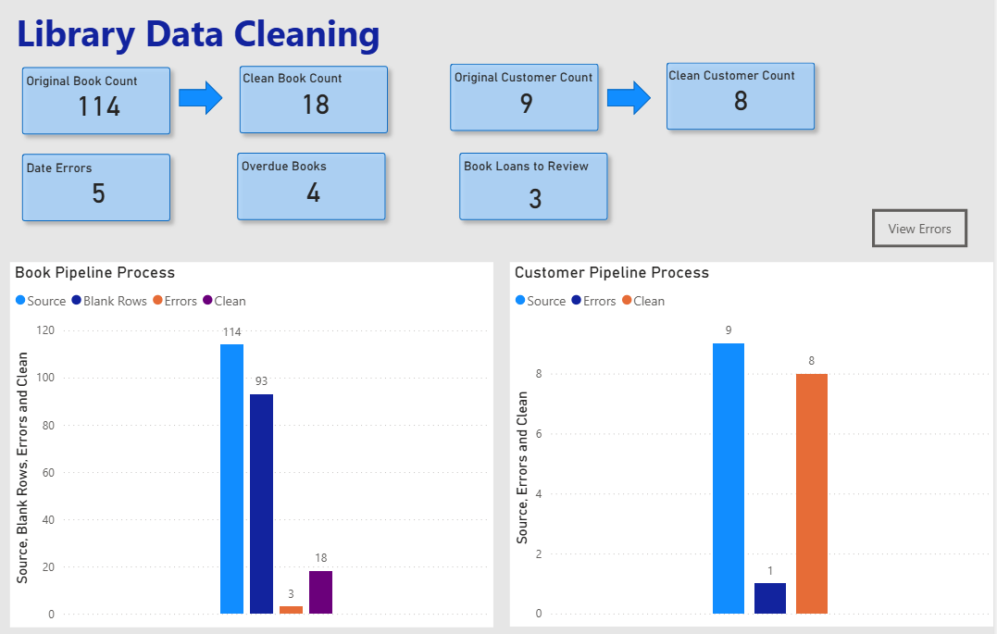
Power Bi Visual Dashboard

Slide 8
Risks & Issues
Poor quality source data (blank rows, invalid values, duplicate records)
Changes to source file (column names, formatting changes)
Incorrect or outdated file uploads
Pipeline or Docker container failure
Legitimate records accidentally removed during cleaning

Slide 9
Swot Analysis
Strengths
Automated data cleaning process
Repeatable and consistent pipeline
Reduced manual processing
Power BI monitoring Dashboard
Weaknesses
Reliance on source data quality
Manual file upload/trigger
Some business duplicates maybe not be detected
Opportunities
CI/CD pipeline Integration
Scheduled Automation
Database integration
Additional validation and business rules
Threats
Incorrect input files uploaded
User error during manual process
Changes to source file structure

Slide 10
Conclusion
Successfully automated the library data cleaning using Python
Generated operational pipeline metrics
Monitoring Power BI Dashboard
Reduced manual processing
Identified future opportunities including automation and validation improvements

